Slide 1
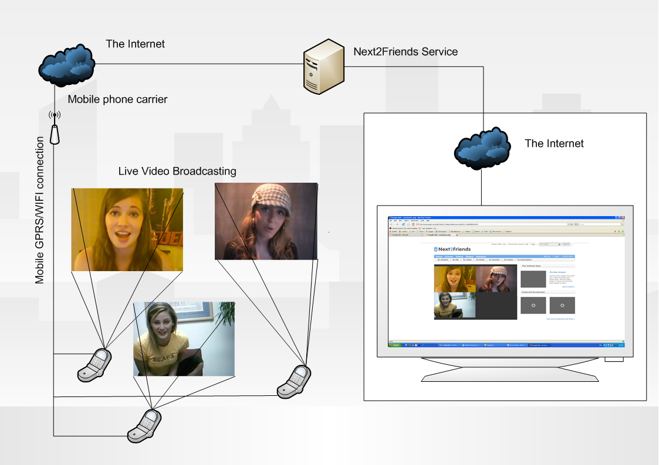
Intelligent Social Matching and Live Broadcasting Network
Investment Opportunity

Slide 2
Presentation Agenda
  Introduction to Next2Friends Inc
    The Story So Far
    Goals and Objectives
      How we Will Achieve The Goals and Objectives
    The Management Team and Leadership
    Solution and Membership Portfolio
  Market Drivers for Intelligent Matching and Live Broadcasting Network
  Target Markets and Sales / Marketing Models
  Key Financials – 3yr Snap Shots
      Management Controls
      Exit and Returns (inc Recent M&A)
  Key Issues
  Competitive Landscape
  Why Invest in Next2Friends?

Slide 3
The Story so Far
  Next2Friends Inc
    UK Ltd Company to be located in Cat Regeneration Area
      Merseyside or Northern Ireland
    C Corp US Subsidiary Company based in Minneapolis, Minnesota
    Sales and Support Operations in UK and Asia
    Pre Revenue
    Built on Friends and Family Sweat Equity/ Capital
    Market Drivers for Intelligent Matching and Live Broadcasting Network
  Patents PATENT PENDING FILE# 60/931,876
  Now looking for Seed Funding of $2M in Exchange for Equity

Slide 4
Goals and Objectives
  Next2Friends Inc will:
    Blend the On-line World with the Mobile World
    Become the Premium Social Networking Group Worldwide by offering;
      Intelligent Matching from Virtual to Reality
      Internet → Mobile → Mobile Blogging → Live Broadcasting Network
      Revenue Generation for Users
      Demographic/ Rules Based Revenue Generation Advertising
  Next2Friends Inc and Their Investors will then become:
    The Cash Cow that You Tube will NEVER be
    The Most Feature Rich Social Network Platform Worldwide
    Enjoy a Large Multiple Exit Company within 4 years

Slide 5
How We Will Achieve Goals and Objectives
  Year 1:
    Raise $2M in seed funding to;
      Complete final stages of development
      Secure Management Team and Staff
      Fund Sales/ Marketing and Operational Plan
      Viral Marketing Campaign
      Launch Service & Generate First Revenues of $300k starting in month 6 with massive growth
  Year 2:
    Growth in revenue to $3.2m and 112k users
    Minor Additions to resources, still maintaining low cost base
    Increase branding and awareness
  Year 3:
    Growth in revenue to $9.1m and 222k users
    Increase branding and awareness
    Align with Exit Partner/s
  Year 4:
    Enjoy a Large Multiple Exit

Slide 6
Management and Leadership Team
  Roy Shelton- Chief Executive Officer
    Serial Start up to Exit Executive
    100% Tech Oriented Global Career
    MBA Graduate
  NN Chief Operating/ Financial Officer
    Serial Start up to Exit Executive
    100% Tech Oriented Global Career
    xx Qualified/ Graduate
  Anthony Nystrom - Chief Development Architect
    10 Years software development. Mobile to Enterprise.
    Innovative, exceptionally creative technology evangelist.
    BS, Computer Science/Mathematics, BA, Biology/Anthropology
  Gary Nystrom – Senior Developer
    30 Years Software developer and analyst.
    Experienced development with largest financial institutions. High Security.
    BS, Chemistry/Mathematics, BA, Health Sciences, Actuary Science
  Lawrence Botley - Lead Developer
    8 Years multifaceted development with Telecom focus.
    4 years contract development, experienced multi-development technologies
    BS, Artificial Intelligence/Computer Science, MS, IT ecommerce

Slide 7
Solution and Membership Portfolio
  Intelligent Matching from Virtual to Reality
  Internet → Mobile → Mobile Blogging → Live Broadcasting Network
  Revenue Generation for Users
  Demographic/ Rules Based Revenue Generation Advertising

Slide 8
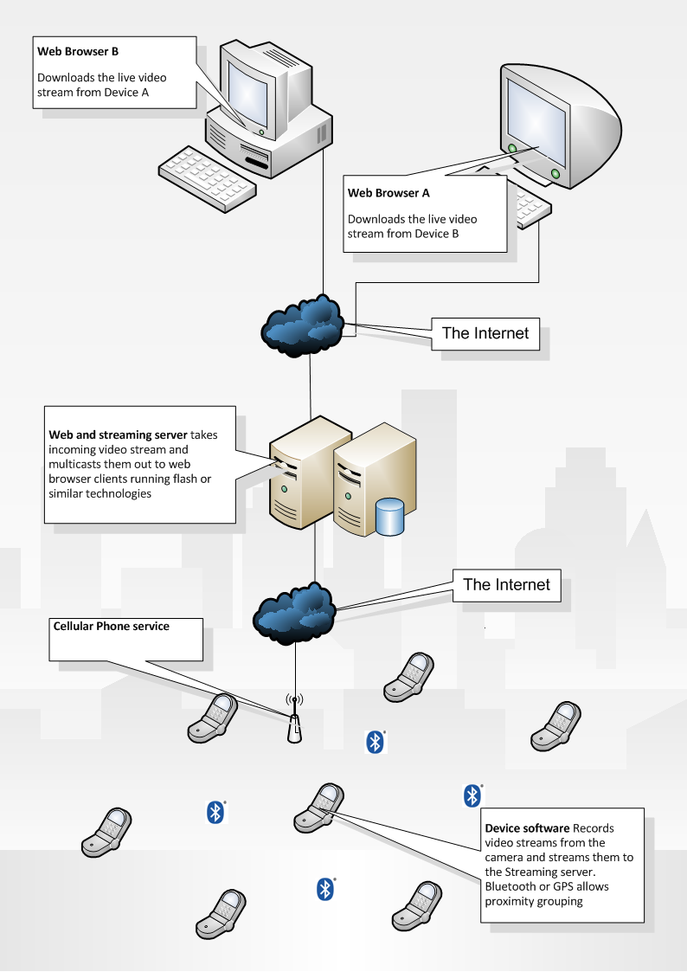
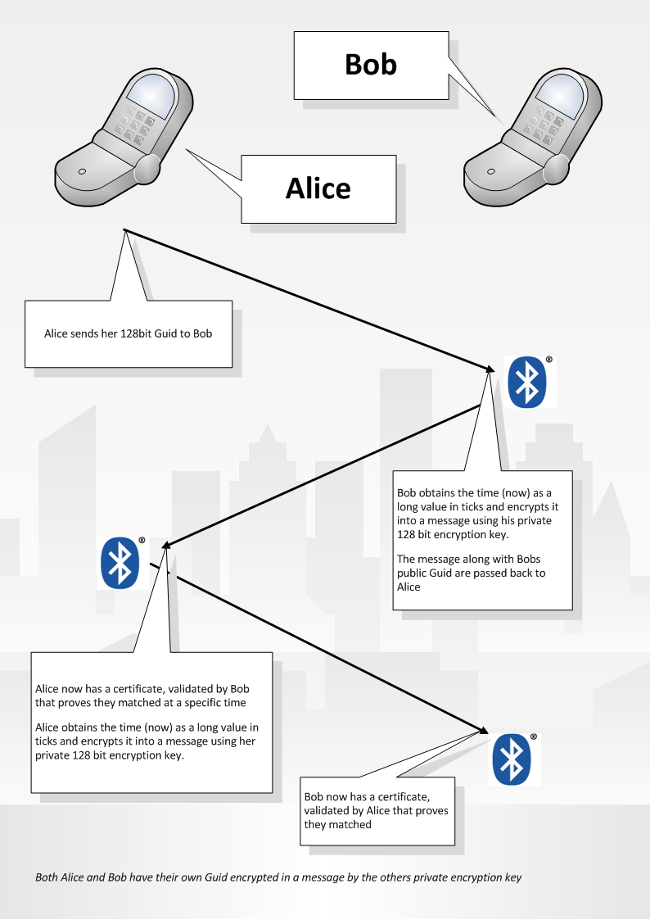
Intelligent Matching from Virtual to Reality
  Real time profile proximity matching.
  More relevant matches. More exciting for user as this is tangible matching vs. Simply online.
  Ad insertion relevant to profiles. Highly Targeted.
  Nothing like it yet in the market

Slide 9
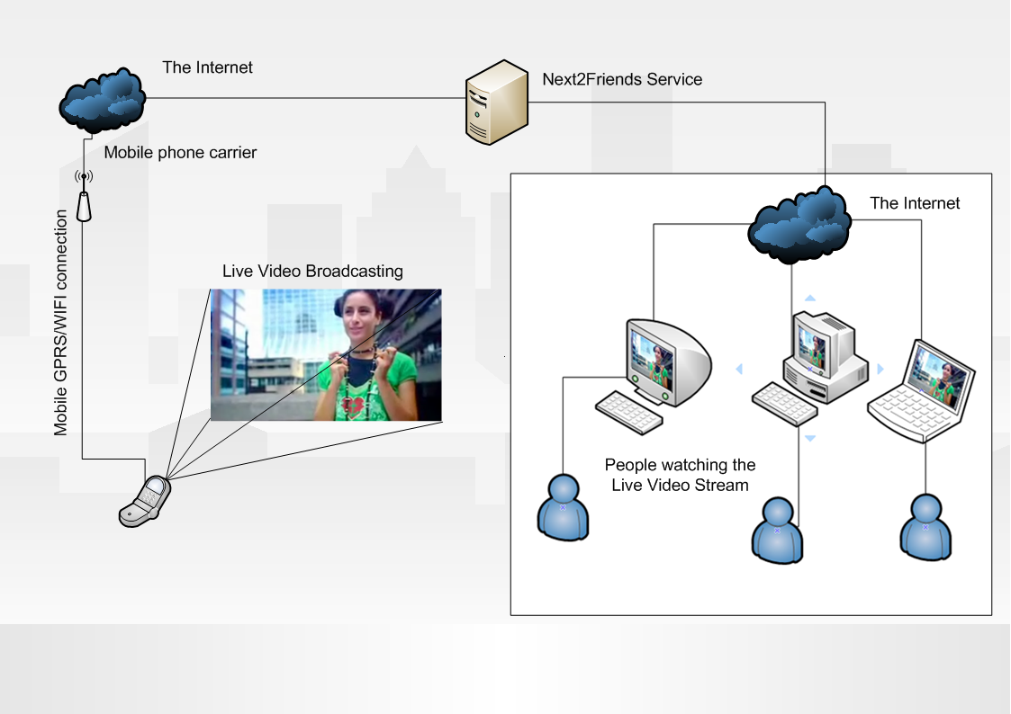
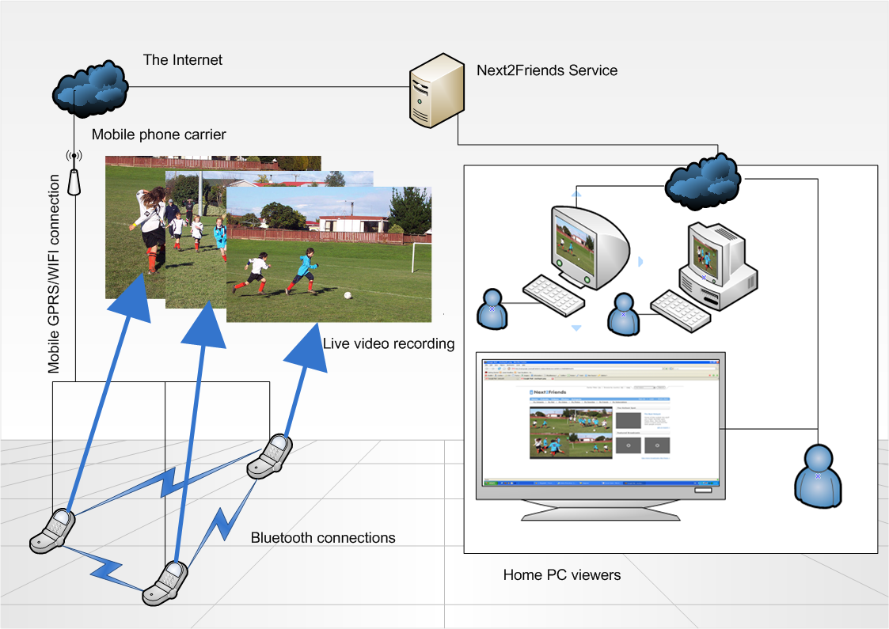
  Internet → Mobile → Mobile Blogging → Live Broadcasting Network
  Live video, anywhere, anyplace and scheduled. Recorded for distribution. Bring your friends, colleagues and family with you.
  From the street to the playground to your own news studio.
  Multi-camera views, just like the real thing. Advertisement insertion, stays with broadcast.
  Revenue for content is ongoing for business partners.
  Ad insertion relevant to profiles.
  Highly Targeted.

Slide 10
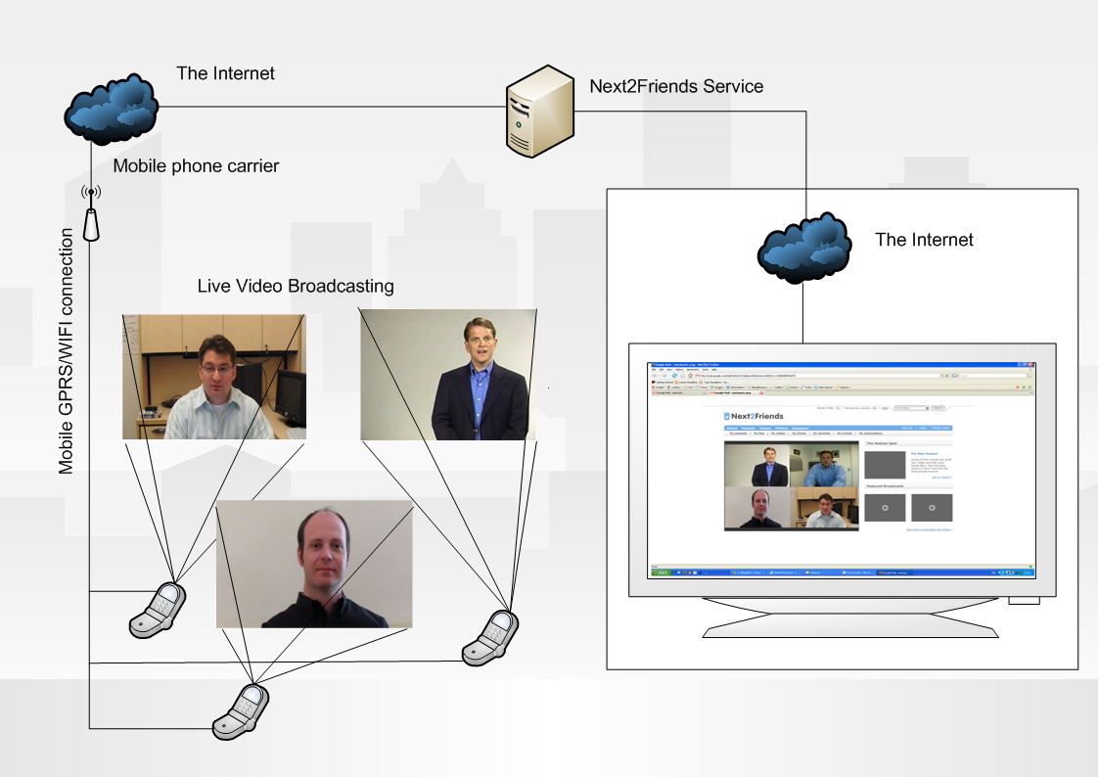
  Mobile Video Conferencing → Live Broadcasting Network
  Live video, anywhere, anyplace and scheduled. Recorded for distribution. Bring your friends, colleagues and family with you. From the street to the playground to your own news studio. Multi-camera views, just like the real thing. Advertisement insertion, stays with broadcast. Revenue for content is ongoing for business partners. Ad insertion relevant to profiles. Highly Targeted.

Slide 11
Revenue Generation for Users
  Ad content revenue is shared with producer (user) Based upon viewing count algorithms, Ad costs and revenue parallel live viewer counts.
  Users always share revenue, from day one
  You Tube for example doesn’t offer live broadcasting, and only now are thinking about ad inclusion.
  Users will migrate to services with guaranteed revenue sharing and technology that allows them to produce from anywhere, not just from their PC.

Slide 12



Revenue Generation for Users

Slide 13
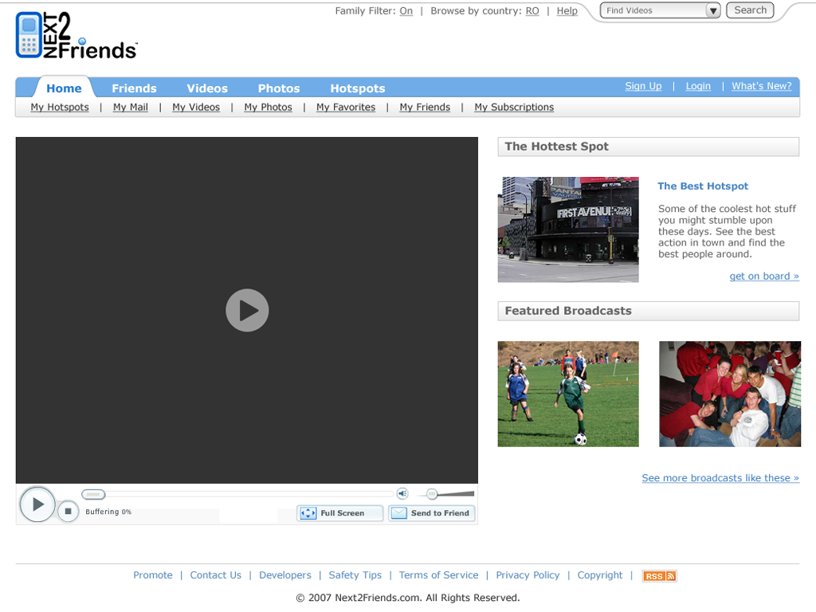


Slide 14
Market Drivers
  Top 10 countries by mobile phone subscribers
    China - 350 Million
    USA - 170 Million
    Japan - 89 Million
    Germany - 68 Million
    Russia - 65 Million
    UK - 58 Million
    Italy - 58 Million
    France - 45 Million
    Spain - 39 Million
    Mexico - 37 Million
  Youtube.com - 20 million visitors each month with 100 million clips viewed daily with an additional 65,000 new uploaded
  36.5 billion SMS messages were sent in 2006
  Jupiter Research estimated that the online dating segment would make around $600 million last year.Match.com makes an estimated $20m a month.

Slide 15


Market Dynamics
  Updated: 9:00 p.m. ET July 6, 2007
    NEW YORK - The Live Earth event on Saturday is set to reach millions more people than previous global productions with its reach boosted by the fast-growing power of Web video sharing and social networks.
    Organizers estimate television broadcasts of the live concerts staged to raise awareness about climate change will be available to up to 2 billion people although there is no estimate of how many people will actually watch the shows.
  Experts says that the number of subscribers will reach 250,000,000 by 2010, and that revenue will reach over $27 billion by that year. Greenfield adds that mobile video isn't that big a step from what we have now, and that the factors are finally lining up to bring it to a mass audience.

Slide 16
Target Market and Sales Model
  Market Size
    +2b Potential Users Worldwide
    Hundreds of Thousands of Corporate Advertisers
    No direct competition for matching outside of online only
  Direct and Indirect Sales Model
    Electronic Direct E-Mail, Banners, Search Engine Manipulation
    Viral and Disruptive Marketing
    Self Propagating Social Network with User Incentives
    Web Broadcasts using Next2Friends Network
    Cool Cult Phenomena Branding and Merchandise
    Charitable Associations and Donations for Increased Global Issue Awareness
    Direct Telesales and Online Sales Team for Corporate Advertising
Time of Day Internet Usage | % of Users
Sporadically Throughout The Day | 47%
First Thing When They Arrive | 25%
At Lunchtime | 18%
During Afternoon Break | 8%
Right Before They Head Home | 2%
Marketing Mix | Percentage Effective
Email Marketing | 83.20%
Search Marketing | 61.70%
Display Ads | 36.20%
Ad Networks | 31.90%
Contextual Targeting | 27.70%
Traditional Direct Marketing | 27.70%

Slide 17
Fee and Earnings Model
  Intelligent Matching from Virtual to Reality
    First Month Free of Charge Against Registration and CC details
    My Friends: $20 per month- inc ads
    My Friends and Interests: $35 per month- exc ads
  Internet → Mobile → Mobile Blogging → Live Broadcasting Network
    First Month Free of Charge Against Registration and CC details
    See My Friends $50 per month- inc ads, exc revenue share- 100 mins pm
      Additional 100 mins pm $50 per month
    DVD Production on All plans @ $5per DVD
  Revenue Generation for Users
    Earn for my Friends: $2 per month revenue share per paying member introduced
    Earn with my Friends: $0.05c per viewing of your production which inc ads
  Demographic/ Rules Based Revenue Generation Advertising
    Win New Friends: $100-200 per month standing min fee from Corporate Clients
    Viewing by Friends: $.20c per viewing of your ads from Corporate Clients

Slide 18
4yr Financial Model- Funding Spend
  Staffing and Resourcing
    Development Team to finally join Full Time
    Sales and Viral Marketing Team
    The Management Team and Leadership to join Full Time
    Branding for Solution and Membership Portfolio
  Capital Equipment
    Office/IT Infrastructure
    All Application/Platform Hosting Outsourced to T1 Vendor with Strong SLA
  Completion of Development
    +80% Complete- Will be live within 4 months of Inward Investment
    20% of Inward Investment to complete development
  Marketing and Branding
  Exit

Slide 19
Management Controls
  Internal Communication and Reporting
    Weekly Group Sales/ Marketing Review and Analysis
    Weekly Management Meeting with Detailed Operational Review
    Weekly Detailed Review and Update with Finance and Operations
    Full and Detailed Monthly Board Report

Slide 20
3yr Financial Model- Cashflow

Slide 21
3yr Financial Model- Balance Sheet

Slide 22
3yr Financial Model- Exit
  Likely Exit Partners
    Google- Extend User Experience
    Yahoo- Complete with Google
    WebEx- Penetrate Hot Spot Market
    New Entrant or Exisisting Competitor
  Target Returns for Investors
    25% Equity Available to Investors for Seed/A Round of $2m
    Market Multiple of 5x Revenue in Yr 3 (
    25% Share =

Slide 23
3yr Financial Model- Exit
  Recent Exits
    Youtube.com - est. 2005
      Youtube.com was acquired by Google Inc in November 2006 for £1.65 Billion in Google stock
      Initially no revenues were built in. Since Google acquisition, YouTube now serves banner ads.
      Google had a video serving website (video.google.com) previous to acquiring YouTube.com. However, it s popularity driven by usability (and it now being dull Google) made it seem like a viable purchase. It is also rumored that Google could have never built a site like this due to the large quantity of unlicensed media. It took a smaller company (who has no money to be sued) to start the online video revolution, get it critical mass where it is profitable and then look for a buyout by a bigger corp.
    MySpace.com - est. 2005
      MySpace.com was acquired by News Corp (Fox) in November 2006 for £$580 Million Cash
      Pre Revenue Music distribution and advertising space
      In October, the site logged 24.2 million unique users, up 12% from 21.6 million in September, according to a new report from researcher comScore Networks
    Match.com - est. 2005
      Match.com was acquired for $249 million by Interactive Corp.
      During 2001, Match.com generated $49.2 million in revenue and $16.5 million in EBITDA with more than 382,000 paying subscribers at the end of the fourth quarter.
      November 2002 - Match.com, launches 25 international local-language dating sites that support local languages and currencies
      Match.com is coming off a record year, with revenue of $311.2 million, a 25% increase from 2005.In 2006, Match.com launched a new site experience and brand campaign in France. Since the launch, the campaign has driven daily Match.com subscriptions up by 66%.

Slide 24
Key Issues
Near term
  Seed/Series A funding to support full time operations
  Time to market, completion of key patents
  Finalize product development
  launch beta product
  Exploit both membership offering (Unique Approach)
Long term
  Can we scale quickly enough for sizeable exit?
  Can we exploit growing demand quickly?
  Can we stave off competitor approaches?

Slide 25
Competitive Landscape
You Tube – Free, Not social networking or matching, just Video. 20 million visitors each month, 100 million clips viewed monthly
Match.com - $29.99 a month ($12.99 if you sign up for six months)
EHarmony.com - $60 a month or $250 per year.
Matchmaker.com - $24.95 per month or $95.95 per year
Friendfinder.com - standard membership $22.94 a month, or $99.94 for Gold
Personals.yahoo.com - $24.95 for "casual" or $39.95 for advanced features

Slide 26
Competitor 1
Est..: 2005
Current Revenues: undisclosed (Acquired by Google for $1.65 Billion)
Current Users: 20 million visitors each month, 100 million clips viewed monthly
Solution and Membership Portfolio
  Youtube - 20 million visitors each month with 100 million clips viewed daily with an additional 65,000 new uploaded
  YouTube is a video sharing website where users can upload, view, and share video clips.
  The service uses Adobe Flash technology to display video.
  The wide variety of site content includes movie and TV clips and music videos, as well as amateur content such as video blogging and short original videos.
  YouTube is staffed by just 67 employees.
How Does Next2Friends Differentiate?
  Youtube - only allows videos to be uploaded or streamed via a webcam for later viewing. The Next2Friends service allows videos to be viewed in real time.
  YouTube does not facilitate mobile phones so members cannot stream directly off their video devices if working away from their PC.Next2friends members are always available to post videos and photos.
  YouTube does not allow have a friend matching system to meet new people

Slide 27
Competitor 2
Match.com
Est.. Yr: 1994
Current Revenues: $249 million (2005), with 26% growth over the previous year.
Current Users: 42 million singles registered globally, 15 million members using the service
Solution and Membership Portfolio
  Match.com is an online dating service. Match.com, Match.com International, and other affiliated businesses span six continents, operating more than 30 dating sites in 18 local languages.
How Does Next2Friends Differentiate?
  Match is focused on couples and the online dating scene whilst next2friends includes all types of people and social interests
  Match is 100% online-Next2friends allows people to meet other that go to the same real life places by Bluetooth tagging
  Match have no video/photo viewing- Next2friends members are able to post videos and photos.

Slide 28
Competitor 3
Est. Yr: 2000
eHarmony
• Current Revenues: $50-100 Million
• Current Users: 13 million (2005)
Solution and Membership Portfolio:
  eHarmony is a marriage-oriented matchmaking website.
  The company does a great deal of advertising through television and the Internet and requires users to complete a detailed compatibility questionnaire.
  The systems research methods and its models for compatibility matching have not been submitted to any peer-reviewed journals for evaluation and publication. This is eHarmony secret recipe and allows it to claim uniqueness in its service.
How Does Next2Friends Differentiate?
  eHarmony is focused on couples and the dating scene whilst next2friends includes all types of people and social interests
  Next2friends improves on eHarmony’s algorithm by indexing live proximity data built into Next2friends device software.
  Next2friends members are able to post videos and photos.
  eHarmony's services are selective, that is, not all who apply for the service are accepted.

Slide 29
Competitor 4
Friend Finder
Est.. Yr: 1996
Current Revenues: undisclosed - ($200 Million revenue from parent company Various Inc.)
Current Users: 25 million (40% annual growth)
Solution and Membership Portfolio
  Friend Finder is a dating site with 25 million active members worldwide.
  Friend Finder owns a number of other similar sites, such as Adult Friend Finder, Fast Cupid and Cams.com.
  Friend finder, Inc.'s different websites have a total worldwide membership of 100 million people.
How Does Next2Friends Differentiate?
  Friend Finder is focused on couples and the dating scene whilst next2friends includes all types of people and social interests
  Next2friends allows people to meet other that go to the same real life places by Bluetooth tagging
  Next2friends members are able to post videos and photos.

Slide 30
Competitor 5
Personals.Yahoo
Est.. Yr: Yahoo established 1995
Current Revenues: £170 Million (2005)
Current Users: 10 Million
Solution and Membership Portfolio:
  Personals. Yahoo is a Profile dating website that states that 75% of its members are looking for the “person that will change their life”.
How Does Next2Friends Differentiate?
  Personals. Yahoo on couples and the dating scene whilst next2friends includes all types of people and social interests
  Next2friends allows people to meet other that go to the same real life places by Bluetooth tagging
  Next2friends members are able to post videos and photos. Personals.
  Yahoo is simple a chat exchange system

Slide 31
Why Invest in Next2Friends
  Huge Growth Market
  Low Cost Base Business Model
  Strong Management Team
  Low Risk Operational Plan
  Clear and achievable goals with SMART KPIs and Control Loops in Place
  Patented Pending Product Offering
  Large Multiple Exit Potential

